Slide 1


CAPSTONE PROJECT
Amazon Products Sales Analysis Dashboard using Power BI
Presented By
Student Name: SREEJA KOLAY
College Name: JIS
Department: BCA(CSE)
Email ID: sreejakolay376@gmail.com

Slide 2
OUTLINE:
Problem Statement
Proposed System/Solution
System Development Approach
Algorithm & Deployment
Result
Conclusion
Future Scope
References

Slide 3
Problem Statement:
Amazon generates a huge amount of sales data across different products, categories, time periods, and regions.
However, raw data alone does not provide meaningful insights for decision-making.
The major challenges include:
Difficulty in tracking sales trends over time
Lack of clarity on top-performing products and categories
No quick way to analyze YTD and QTD performance
Manual reporting methods are time-consuming and error-prone
Hence, there is a need for an interactive and visual analytics system that can transform raw sales data into actionable insights.

Slide 4
Proposed Solution:
The proposed system is an interactive Amazon Sales Analysis Dashboard developed using Microsoft Power BI.
The solution provides:
Real-time visualization of YTD Sales, QTD Sales, Products Sold, and Reviews
Monthly and weekly sales trend analysis
Category-wise and product-wise sales insights
Top 5 products based on sales and customer reviews
User-friendly filters for Product Category and Quarter
This dashboard helps stakeholders make data-driven business decisions quickly and efficiently.

Slide 5
System Approach:
System Requirements
Microsoft Power BI Desktop
Amazon sales dataset (CSV / Excel)
Windows Operating System
Libraries / Tools Used
Power BI (DAX, Power Query)
Data Modeling techniques
Interactive Visuals and Slicers

Slide 6
Algorithm & Deployment:
Algorithm / Logic Used
Data aggregation using SUM, COUNT
Time-based calculations using YTD and QTD DAX functions
Ranking logic for Top 5 products
Date table creation for accurate time intelligence
Deployment
Dashboard developed in Power BI Desktop
Can be published to Power BI Service
Accessible via web or shared within organization

Slide 7
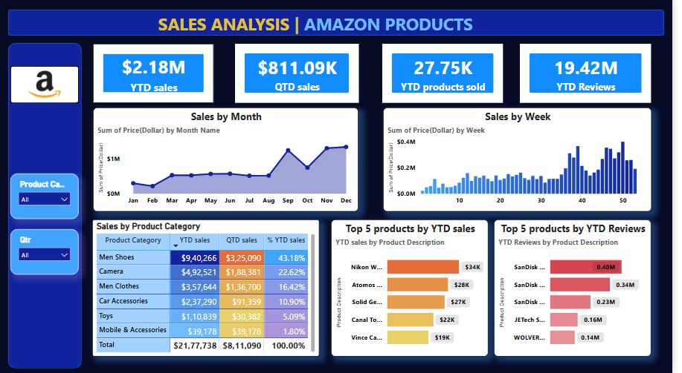
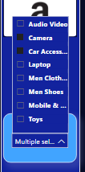
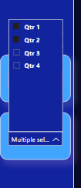
Result:

Slide 8
Conclusion:
The Amazon Sales Analysis Dashboard successfully converts complex sales data into meaningful visual insights.
It enables:
Faster analysis
Better understanding of sales performance
Identification of top products and categories
This system improves decision-making efficiency and reduces manual reporting efforts.

Slide 9
Future scope:
Integration with real-time Amazon sales APIs
Addition of customer demographics analysis
Predictive sales forecasting using machine learning
Mobile-friendly dashboard version
Role-based access control

Slide 10
References:
Microsoft Power BI documentation
Amazon sales dataset https://docs.google.com/spreadsheets/d/1G7PYXLzfx6vfpmGOujSa1-CYzpufrkCo/edit?usp=sharing&ouid=117430849960514197097&rtpof=true&sd=true
DAX guide https://dax.guide/
Power BI community resources
GitHub Link: Link

Slide 11
Thank You

